Slide 1


OpenADR 2.0 Multiple Transport
Reference Architecture
Spring 2012 EOSP Argonauts Team
Presented by
Dandan Zheng
Tharanga Gamaethige

Slide 2
Spring 2012 EOSP Agenda
Team
Project
Progress
Approach
Lessons
Roadmap

Slide 3





Argonauts Team
Siddharth Subramanian
Planning Manager
Matt Lenzo
Development Lead
Rui Li
Team Lead
Dandan Zheng
Chief Architect
Tharanga Gamaethige
Quality Assurance Lead

Slide 4



Studio Mentors
Grace
Lewis
Mel Rosso-
Llopart
Bradley
Schmerl

Slide 5

Client – EnerNOC, Inc.
A leading provider of energy management
applications for the smart grid
www.enernoc.com
Jake Thompson
Mgr. of Advanced Technology
EnerNOC, Inc.

Slide 6
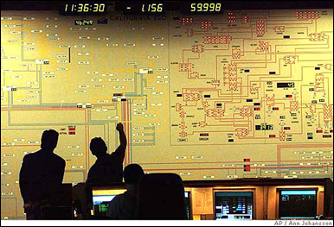





Project Context – Demand Response
1
2
Demand Response Event
Peak energy usage
Emergency curtailment
Utility/Grid Operator
Notification
Execute Energy Reduction Plans
3
Industrial
Institutional
Commercial
Feedback
Notes:
- Our system will reside with energy aggregators, such as EnerNOC to handle notification and feedback

Slide 7

Project Scope – Automated Demand Response
Feedback
Notification
VEN
Lighting
HVAC
<OpenADR 2.0 />
Machinery
Virtual Top Node
(EnerNOC)
Virtual End Node (Customer)
1,000 Nodes
Large Industrial
Business Goals
Scalable demand response
Lower implementation costs
Real-time monitoring and control
100,000 Nodes
Small Commercial
1,000,000 Nodes
Residential
Notes:
- Project scope is denoted by the grey dotted box

Slide 8
Project Objectives
Design an architecture for the VTN in accordance with the OpenADR 2.0 standard that supports multiple transport protocols
Evaluate this architecture in terms of its performance and scalability
Produce a reference implementation to demonstrate key design decisions and serve as a model for developers in the OpenADR community

Slide 9
Project Strategy
1st Semester - 2011
2nd Semester - 2012
3rd Semester - 2012
4th Semester - 2012
Sep | Oct | Nov | Dec | Jan | Feb | Mar | Apr | May | Jun | Jul | Aug | Sep | Oct | Nov | Dec
Identify, define, and refine architectural drivers in iterative manner
Implement, integrate, and verify the architecture
Transition activities,
Postmortem
Create and refine architecture through evaluation and experimentation
Kickoff
Sep 23
Protocol Selection
Arch.
Design
Core Implementation
Reference Implementation
SOW
ADD*, White Paper
*Architecture Design Document
Notes:
System wide architecture design is in place, but we verified it through just informal reasoning. This project requires harder evidence. Therefore we need to get more confidence on the design through experimentation or formal modeling.
Our process is based on ACDM

Slide 10


Spring 2012 – Semester Goals
Stabilize requirements by mid-semester
Start architecture design by mid-semester
Reach “period of certainty” by end of semester

Slide 11
Spring 2012 Summary
January
February
March
April
May
1 | 2 | 3 | 4 | 5 | 6 | 7 | 8 | 9 | 10 | 11 | 12 | 13 | 14 | 15 | 16 | 17
ACDM Stages
Stage 1: Discovered architectural drivers
Stage 2: Confirmed project scope
ACDM Stages (Iteratively)
Stage 3: Created/Refined architecture
Stage 4: Evaluated the architecture design
Stage 5: Made production decisions
Stage 6: Conducted few experiments
Production
Decision
Protocols Selected
QAW
MOSP
EOSP
Production
Decision
Architecture Designed
5
6
7
10
8
9
Iterations

Slide 12
Approach
Requirements / Design / Management / Quality / Risk
Requirements Management
Architecture Design
Project Management
Quality Assurance
Risk Management

Slide 13
Requirements Strategy
Requirements / Design / Management / Quality / Risk
Elicit
Analyze
Document
Verify
Operational requirements
Business and technical constraints
Quality attribute requirements
Clarify
Prioritize
Model
Architecture Drivers
Specification
Architecture design
Experimentation
Usage scenarios

Slide 14
Summary of Architectural Drivers
Requirements / Design / Management / Quality / Risk
High Priority Quality Attributes (QA)
Scalability
Protocol Extensibility
Service Extensibility
Medium Priority QAs
Performance (latency, throughput)
Deployability
Reliability (fault detection)
Low Priority QAs
Security (confidentiality)
Availability (recovery)
Category | # | Volatility
QA Scenarios | 10 | TODO
Functional Use Cases | 16 | TODO
Technical Constraints | 11 | TODO
Business Constraints | 9 | TODO
Functional Requirements
Core message exchange patterns
OpenADR services
System configuration
Front-end command and control

Slide 15
Approach
Requirements / Design / Management / Quality / Risk
Requirements Management
Architecture Design
Project Management
Quality Assurance
Risk Management

Slide 16
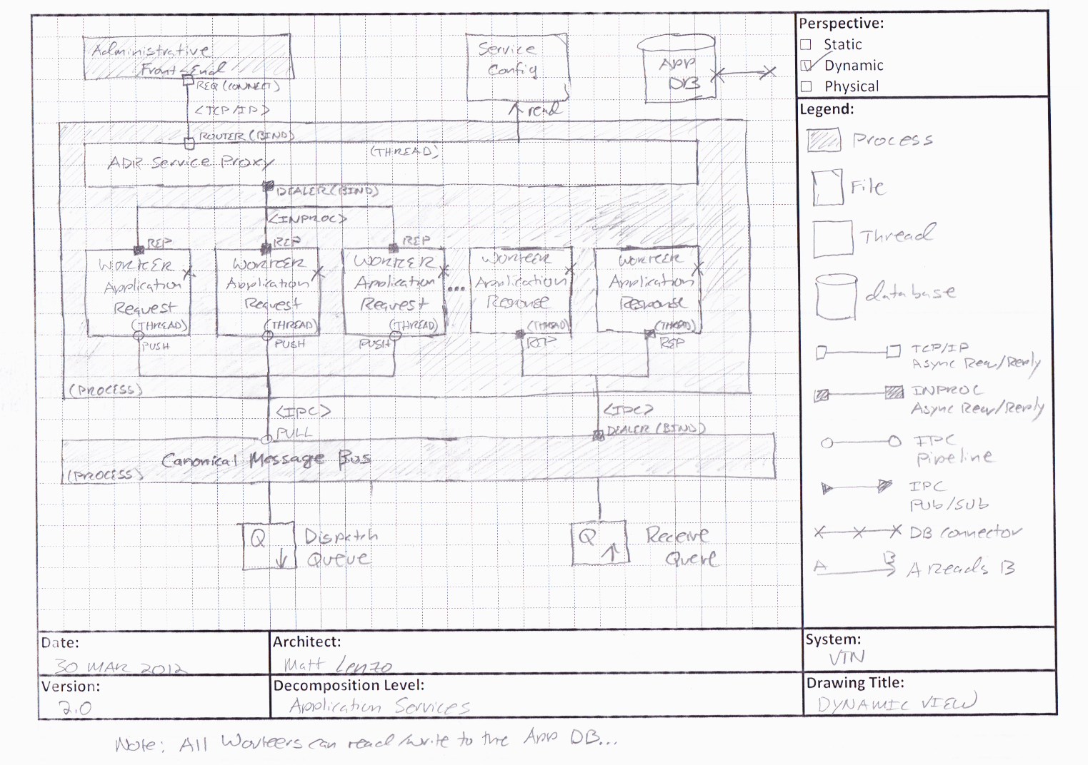
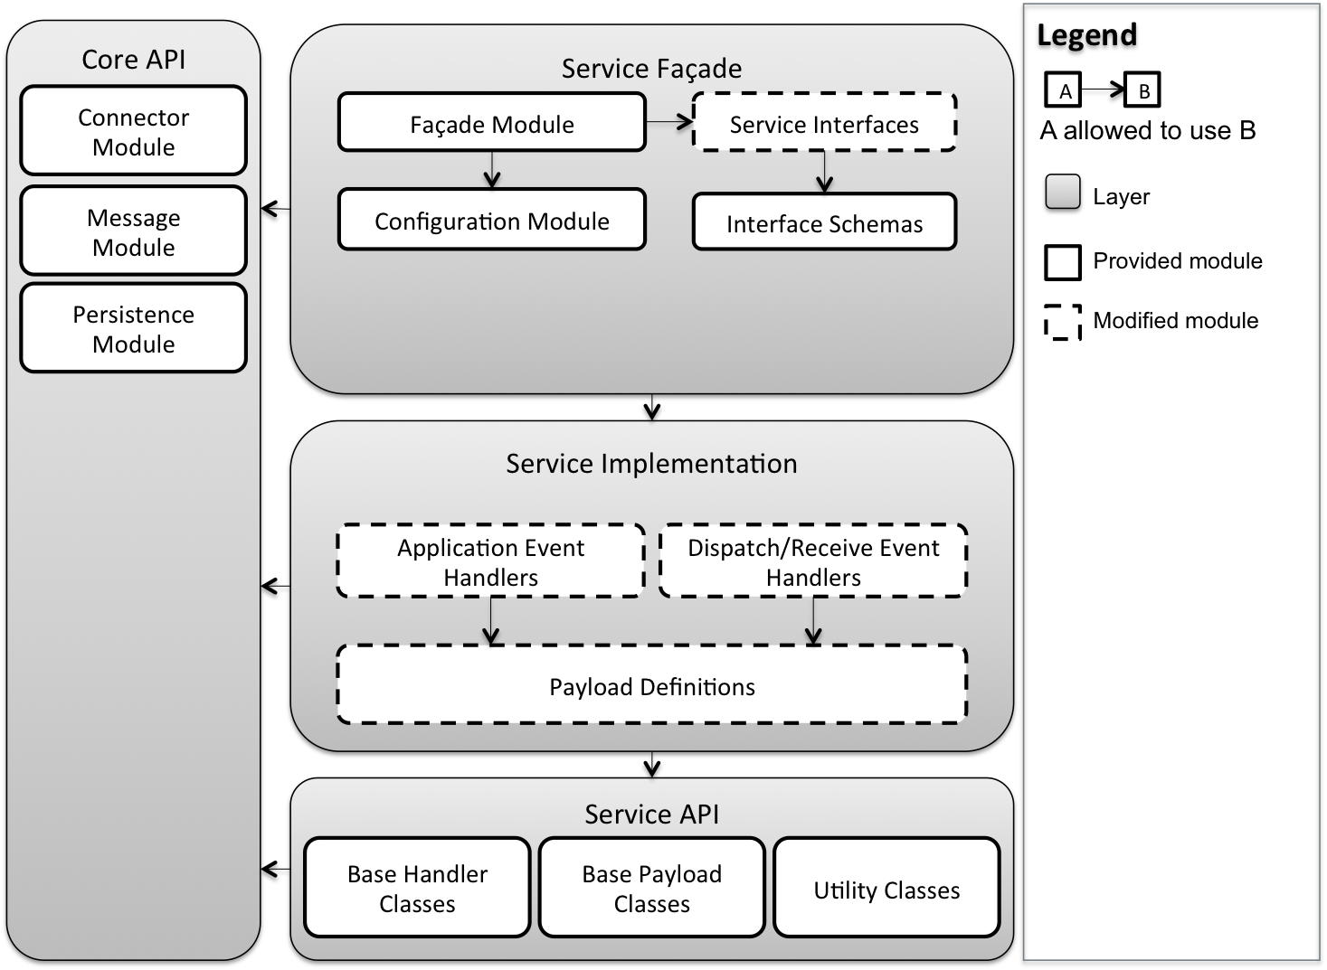
Architecture Design Process
Requirements / Design / Management / Quality / Risk
Short design iterations
Breadth first vs. depth first
Low-fidelity to higher fidelity
Design
Peer Review
Client Feedback
ADEW*
Documentation
and
Issue Analysis
*Architecture Design Evaluation Workshop
Notes:
Short design iterations: ensure convergence of designs and gather client feedback

Slide 17
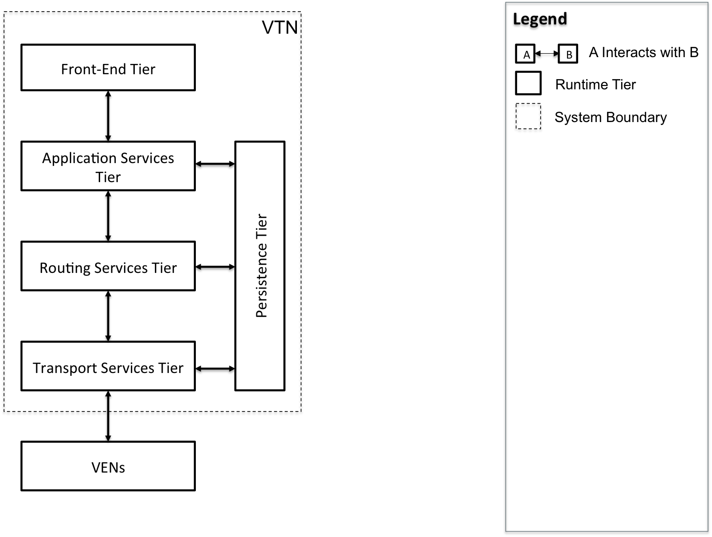
Dynamic Perspective, High-Level Context
Requirements / Design / Management / Quality / Risk

Slide 18
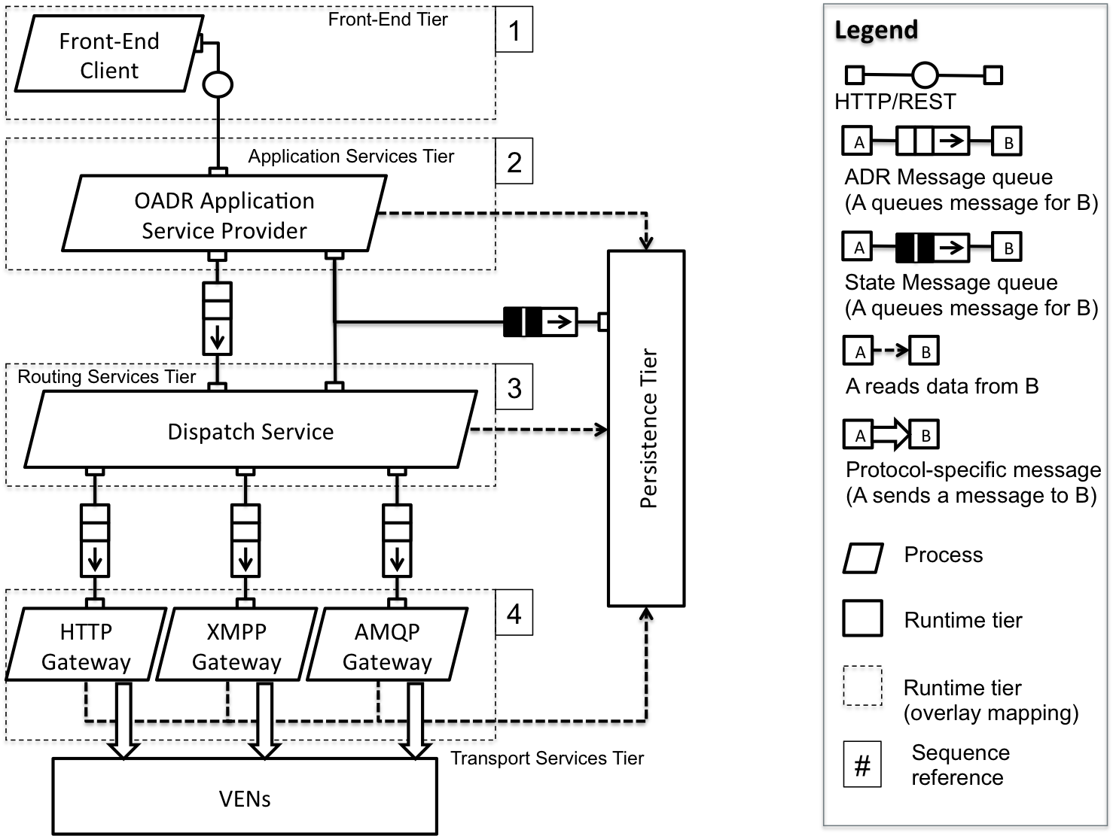
Dynamic Perspective, Outbound Message Flow
Requirements / Design / Management / Quality / Risk

Slide 19
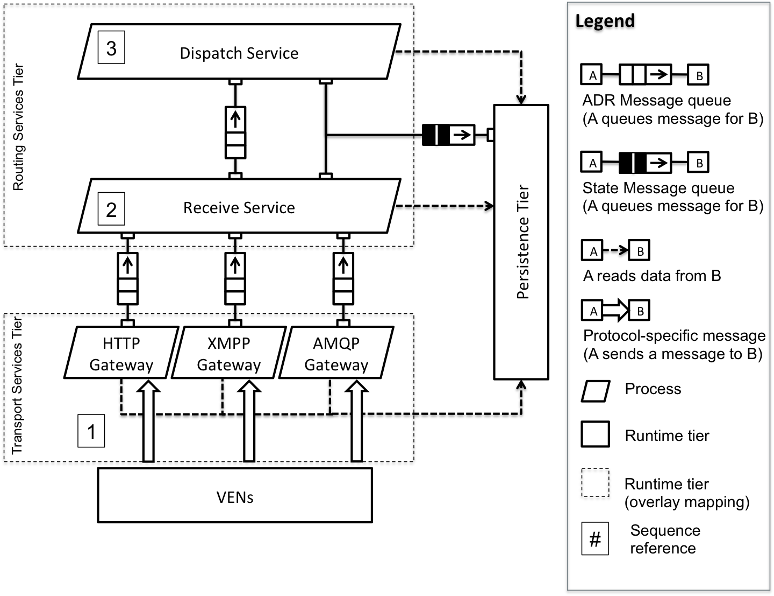
Dynamic Perspective, Inbound Message Flow
Requirements / Design / Management / Quality / Risk

Slide 20
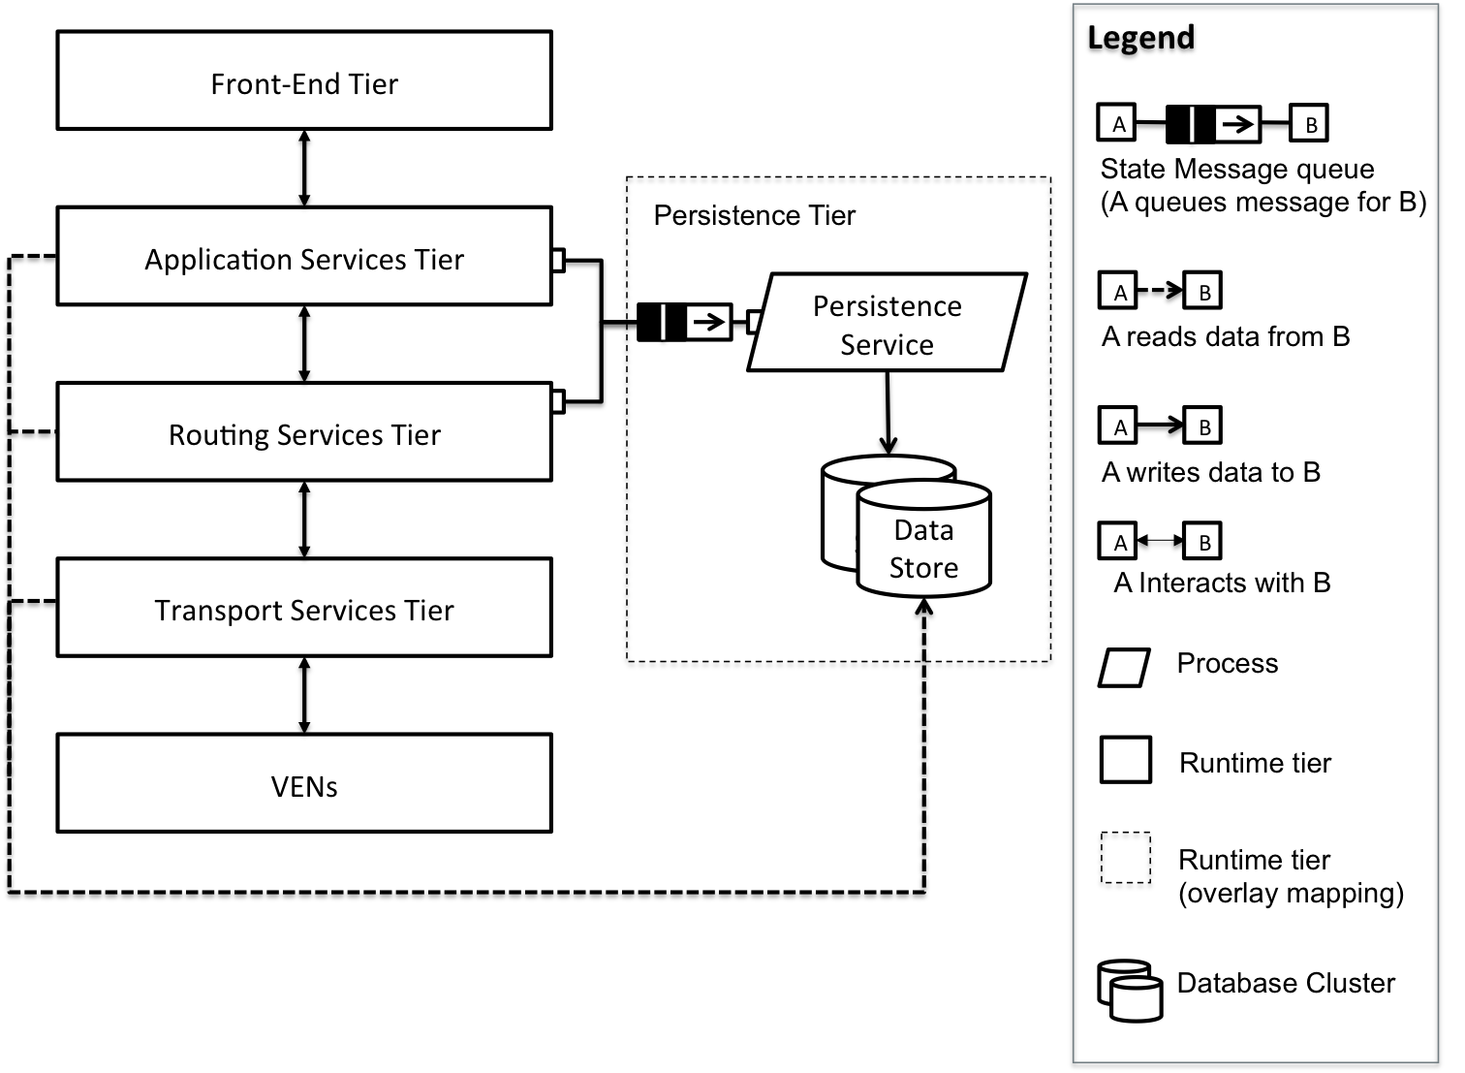
Dynamic Perspective, Persistence Tier
Requirements / Design / Management / Quality / Risk

Slide 21
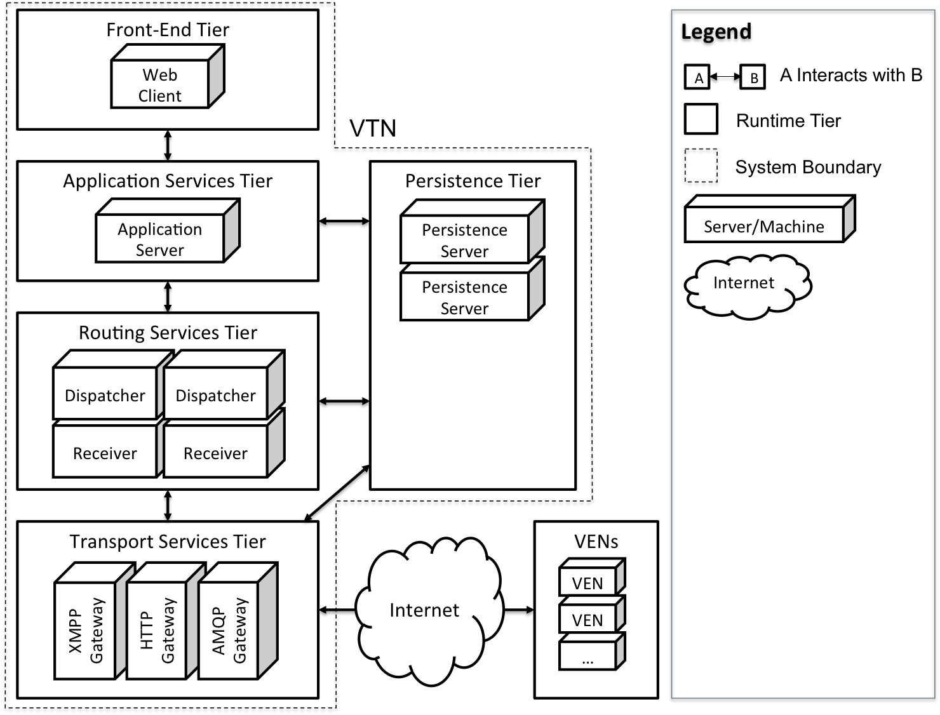
Physical Perspective, Allocation View
Requirements / Design / Management / Quality / Risk

Slide 22
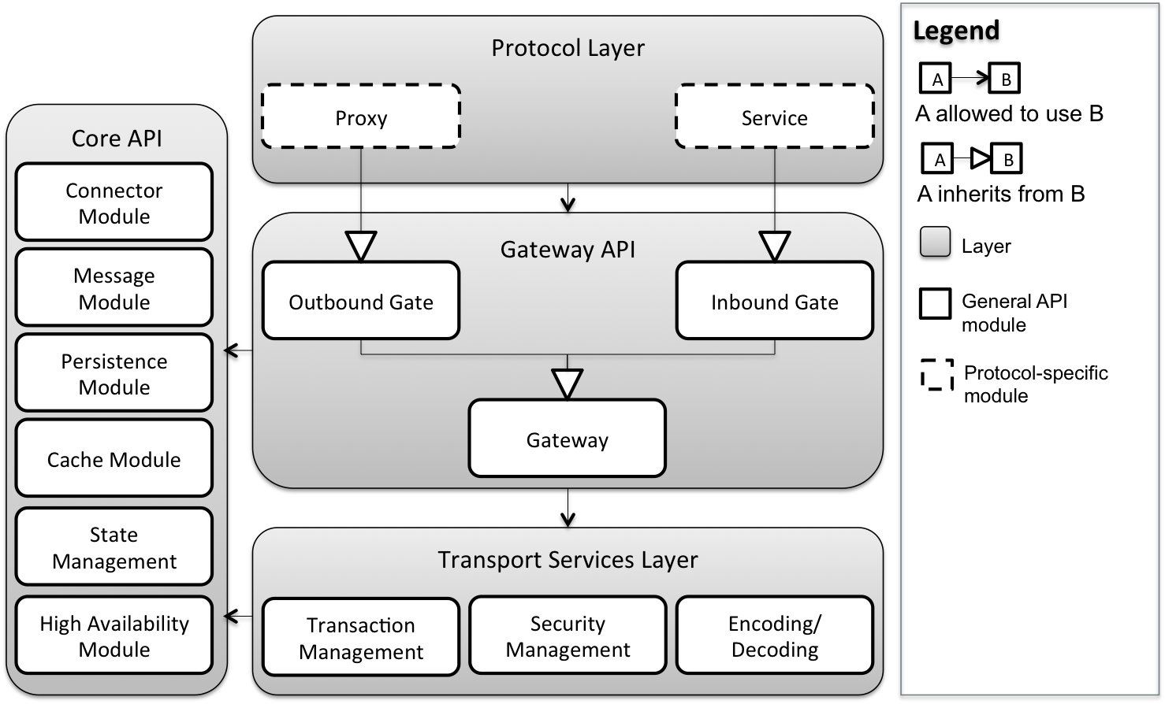
Static Perspective, Protocol Gateway API
Requirements / Design / Management / Quality / Risk

Slide 23
Approach
Requirements / Design / Management / Quality / Risk
Requirements Management
Architecture Design
Project Management
Quality Assurance
Risk Management

Slide 24
Change in Planning Process
Requirements / Design / Management / Quality / Risk
Old Planning Process
Planning, estimation, and tracking using excel sheets
Estimation at the task-level in person-hours
Lengthy planning meetings and overhead activities
Goals
Maximize effort spent on design activities
Minimize the effort spent on overhead and unplanned activities
Accommodate creative design process and technical uncertainties
Provide more visibility into the plan and the planning process

Slide 25

Change in Planning Process
Requirements / Design / Management / Quality / Risk
Solutions:
Time-boxed planning and reflection meetings
Shorter iterations: Plan more, plan often
Work package estimation through planning poker
Tracking through velocity points
Accountability through standup meetings and constant communication
Online planning and tracking tool –

Slide 26
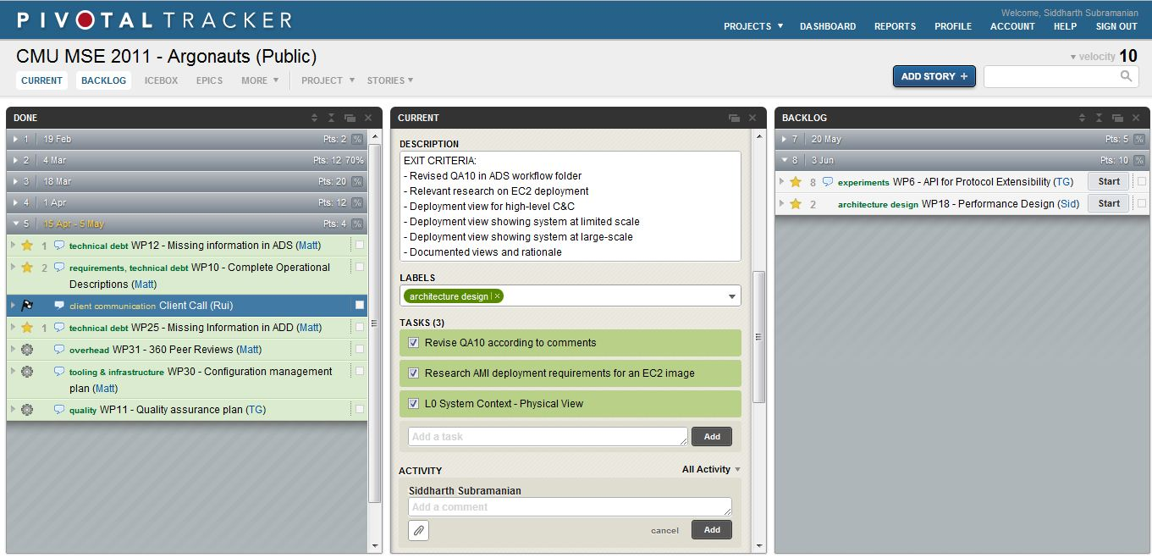
Pivotal Tracker Features
Requirements / Design / Management / Quality / Risk
Notes:
Estimated velocity for an iteration, which stabilizes after 3-4 iteration.
Estimation at the work-package level, as compared to task level using planning poker
Tasks enumerated under every work package
Clear entry and exit criteria for every work package

Slide 27
Planning Reflections
Requirements / Design / Management / Quality / Risk
Measuring overhead and unplanned activities gave an indication to change the process.
Planning more, planning often is very useful when there are technical uncertainties.
Pivotal Tracker increases the visibility of project management.
Pivotal Tracker works well for tracking small work packages consisting of few tasks.
Pivotal Tracker will not work in summer due to the expected increase in the number of work packages and tasks. More granularity is needed in summer.

Slide 28
Approach
Requirements / Design / Management / Quality / Risk
Requirements Management
Architecture Design
Project Management
Quality Assurance
Risk Management

Slide 29
Quality Assurance
Requirements / Design / Management / Quality / Risk
“Quality is free” – Philip Crosby
“When there is no notion of quality, productivity is infinite” - Argonauts
Notes:
- Phil Crosby used the quote “Quality is free” to explain the definition of quality to executives in terms they can understand. We are using how productivity and quality are related to explain why we didn’t get the initial productivity we planned as we figure out the importance of quality.

Slide 30
Goals
Requirements / Design / Management / Quality / Risk
To assure quality of the reference architecture and related deliverables as required by the customer – All attributes of the architecture are verified before the final delivery
To ensure the quality of internal processes which are used to produce client deliverables – Continuously measuring and observing the health and status of internal processes
Notes:
- Phil Crosby used the quote “Quality is free” to explain the definition of quality to executives in terms they can understand. We are using how productivity and quality are related to explain why we didn’t get the initial productivity we planned as we figure out the importance of quality.

Slide 31
Activities in Spring 2012
Requirements / Design / Management / Quality / Risk
Product Quality
Requirements reviews
Peer reviews
Architecture Design Evaluation Workshop (ADEW)
Process Quality
Process quality metric
ETVX* for planned tasks
Managing technical debt
*Entry-Task-Validation-Exit

Slide 32
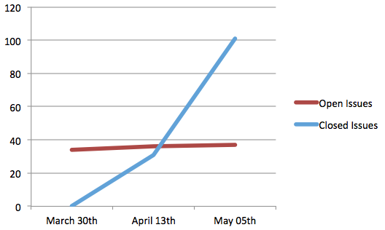
Architecture Design Evaluation Workshop (ADEW)
Requirements / Design / Management / Quality / Risk
Conducted at the end of every iteration to review the architecture design, identify issues and make the production go/no-go decision

Slide 33
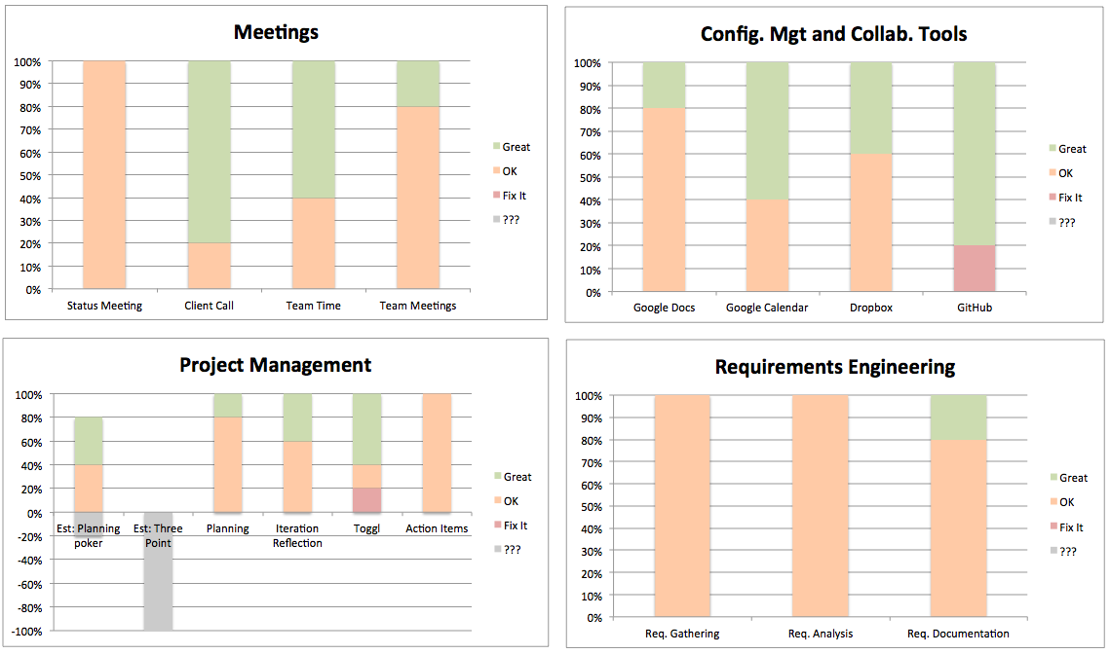
Process Quality Metric
Requirements / Design / Management / Quality / Risk
Bi-weekly process evaluation provided visibility into the health and status of internal processes
Made corrective actions based on team feedback

Slide 34
Managing Technical Debt
Requirements / Design / Management / Quality / Risk
Managed two week iterations without losing the sight of quality of deliverables through technical debt
Provided insights into quality related issues of tasks, individuals and processes
Notes:
- Identifying types of technical debts
- Providing visibility into technical debt by putting them into the product backlog

Slide 35
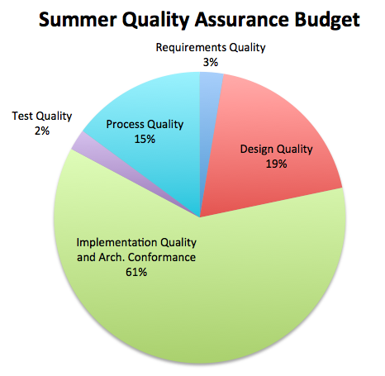
Eye to the future
Requirements / Design / Management / Quality / Risk
A detailed quality plan created with activities and estimates for summer 2012
Quality processes that could improve the quality of both the product and internal processes

Slide 36
Reflections on Quality Assurance
Requirements / Design / Management / Quality / Risk
Having experienced people in the workshop is crucial to maximizing the value of the review
Correct lightweight methods can add more or equal value to the project as heavyweight methods
Managing time-boxed iteration with quality is a challenge as well as an opportunity
Notes:
- Qualitative methods works as long as individuals are committed and honest

Slide 37
Approach
Requirements / Design / Management / Quality / Risk
Requirements Management
Architecture Design
Project Management
Quality Assurance
Risk Management

Slide 38
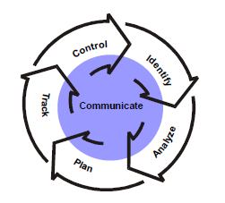
Risk Management Process
Requirements / Design / Management / Quality / Risk
Identification
Format : Condition + Consequence
Mini Team SRE (Software Risk Evaluation)
Team members report every two weeks status meeting
Analyze
Matrix of impact and possibility
Prioritize by muti-voting
Plan
Mitigation strategy for Top 3
Track
Risk Manager report risks status in status meeting every two weeks
Risk Repository
Control
Before iteration plan, reevaluate the risks in risk repository.
Put the mitigation task into backlog

Slide 39
Top 3 Risks –Continued
Risk | Mitigation | Trigger
Transport-level security decision not yet finalized in the OpenADR specification Consequence: Cannot finalize the architecture design | Continuous communication with customer Isolate transport security components to enable extensibility | No formal discussion about security in the first week in summer There is no stable requirement on system security before the second week in summer Design doesn’t meet security requirement by the second week of summer

Slide 40
Top 3 Risks –Continued
Risk | Mitigation | Trigger
Team will use AWS for architecture verification and may exceed allocated budget; the team may overrun its budget given by the customer | Define the budget before doing verification on AWS and continuously monitor actual cost against budget Test approval process | The team still do not familiar with AWS at the end of second week in summer Test plans have no defined budget before execution

Slide 41
Top 3 Risks –Continued
Risk | Mitigation | Trigger
No hands-on experience with large-scale systems and technical knowledge on protocol transports; may be not able to design the multi-transport architecture | 1. experiments for protocol (half done) 2. short and iteratively design on protocol Extensibility and get feedback from mentors and customer (executing)" | "1. No one start to learn protocols before the end of spring semester . 2. No experiments design for simulate the protocol work

Slide 43
Legend:
Overhead
High-Level Design
Detail Design and Impl.
Verification
Week 1
Week 2
Iteration 12
Tools and Infrastructure
AWS Training
Security Design and Exp.
Protocol Extensibility Exp.
Performance Exp.
Scalability Exp.
Service API Stub

Slide 44
Legend:
Overhead
High-Level Design
Detail Design and Impl.
Verification
Week 1
Week 2
Week 3
Week 4
Iteration 12
Iteration 13
Tools and Infrastructure
AWS Training
Security Design and Exp.
Protocol Gateway API
Protocol Extensibility Exp.
Design Refinement
Performance Exp.
Availability Exp.
Scalability Exp.
Service API Stub
Database Design & Impl.
Verification Plan

Slide 45
Legend:
Overhead
High-Level Design
Detail Design and Impl.
Verification
Week 1
Week 2
Week 3
Week 4
Week 5
Week 6
Iteration 12
Iteration 13
Iteration 14
Tools and Infrastructure
AWS Training
Security Design and Exp.
Protocol Gateway API
Protocol Gateways
(XMPP/HTTP/AMQP)
Protocol Extensibility Exp.
Design Refinement
Performance Exp.
Availability Exp.
Detail Design and Impl.
Core API
Scalability Exp.
Service API Stub
Database Design & Impl.
Test Infrastructure
Verification Plan
Verification Plan

Slide 46
Legend:
Overhead
High-Level Design
Detail Design and Impl.
Verification
Week 7
Week 8
Iteration 15
Verification of
scalability, performance, and availability
Design and implementation refactoring

Slide 47
Legend:
Overhead
High-Level Design
Detail Design and Impl.
Verification
Week 7
Week 8
Week 9
Week 10
Iteration 15
Iteration 16
Verification of
scalability, performance, and availability
Dispatch Service
Receive Service
Design and implementation refactoring
OADR Application Services

Slide 48
Legend:
Overhead
High-Level Design
Detail Design and Impl.
Verification
Week 7
Week 8
Week 9
Week 10
Week 11
Week 12
Iteration 15
Iteration 16
Iteration 17
Verification of
scalability, performance, and availability
Dispatch Service
OpenADR Services
Receive Service
Design and implementation refactoring
OADR Application Services

Slide 49
Acceptance Criteria
An architecture that supports XMPP, HTTP, and AMQP transports
An analysis of scalability and performance thresholds
A reference implementation appropriate for demonstrating and verifying key architectural qualities
Well-documented design rationale

Slide 50
QA01 – Scalability Scenario
QA01 | Scalability
Source of Stimulus | An aggregator increases the size of its DR network
Stimulus | VTN utilization increases; the number of messages exchanged with VENs increases
Environmental Conditions | The VTN is at its peak capacity and serving 50,000 VENs Additional VENs will cause a degradation in response time
Architectural Elements | Routing Services Tier, Persistence Tier, Transport Services Tier
System Response | Additional VENs are added to the network New Dispatcher, Receiver, or Gateway instances are launched
Response Measures | No degradation in performance VTN should maintain 200 message per sec throughput Inbound and outbound messages processed in 500 ms

Slide 51
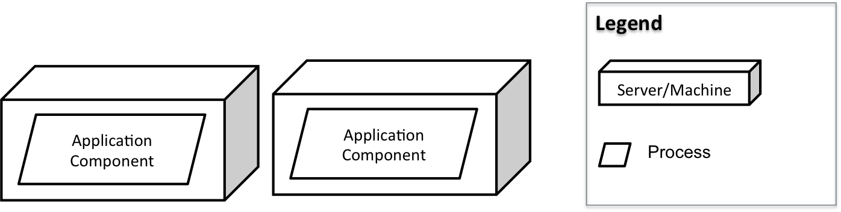
QA01 – Scalability Design Decisions
Redundant hosting of application components with medium size servers

Slide 52
QA01 – Scalability Design Decisions
Redundant hosting of application components with medium size servers

Slide 53
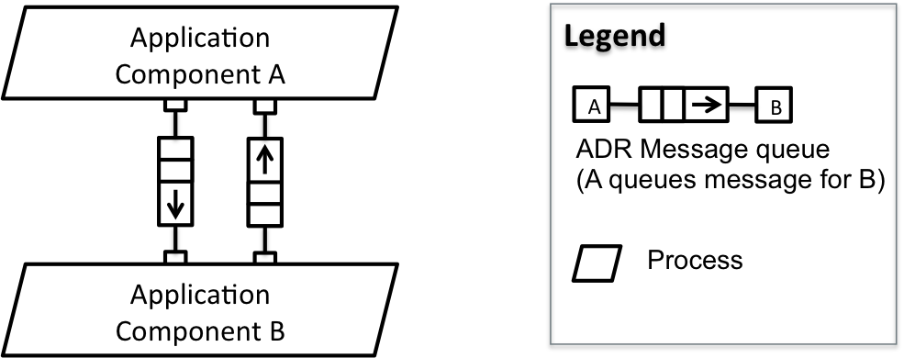
QA01 – Scalability Design Decisions
Event-driven asynchronous communication

Slide 54
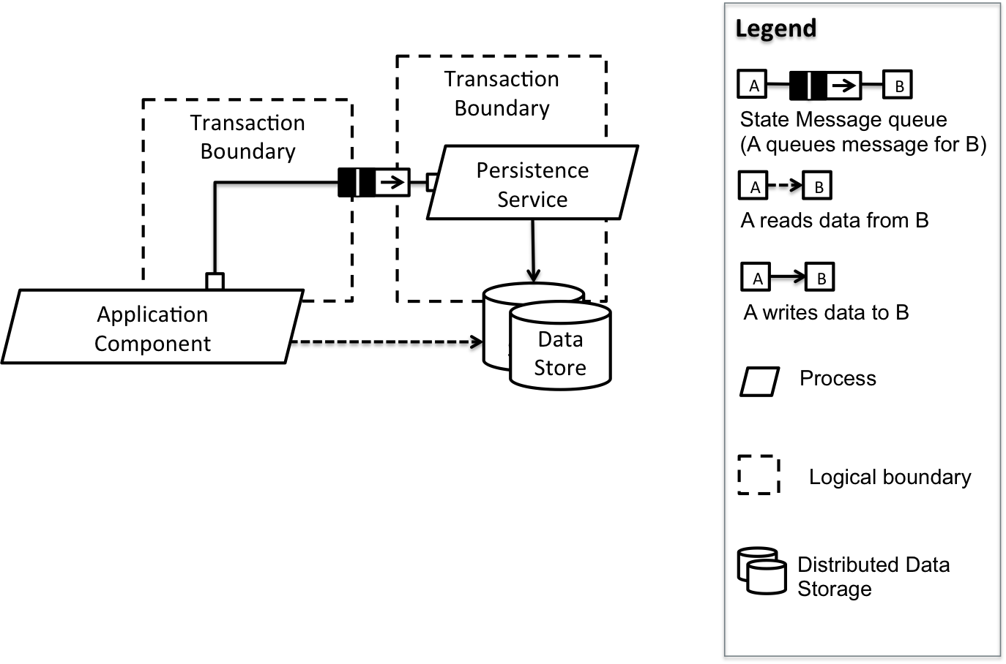
QA01 – Scalability Design Decisions
Command Query Responsibility Segregation (CQRS)
Avoid distributed transactions

Slide 55
QA06 – Protocol Extensibility Scenario
QA06 | Protocol Extensibility
Source of Stimulus
Stimulus
Environmental Conditions
Architectural Elements
System Response
Response Measures

Slide 56
QA07 – Service Extensibility Scenario
QA06 | Protocol Extensibility
Source of Stimulus
Stimulus
Environmental Conditions
Architectural Elements
System Response
Response Measures

Slide 57
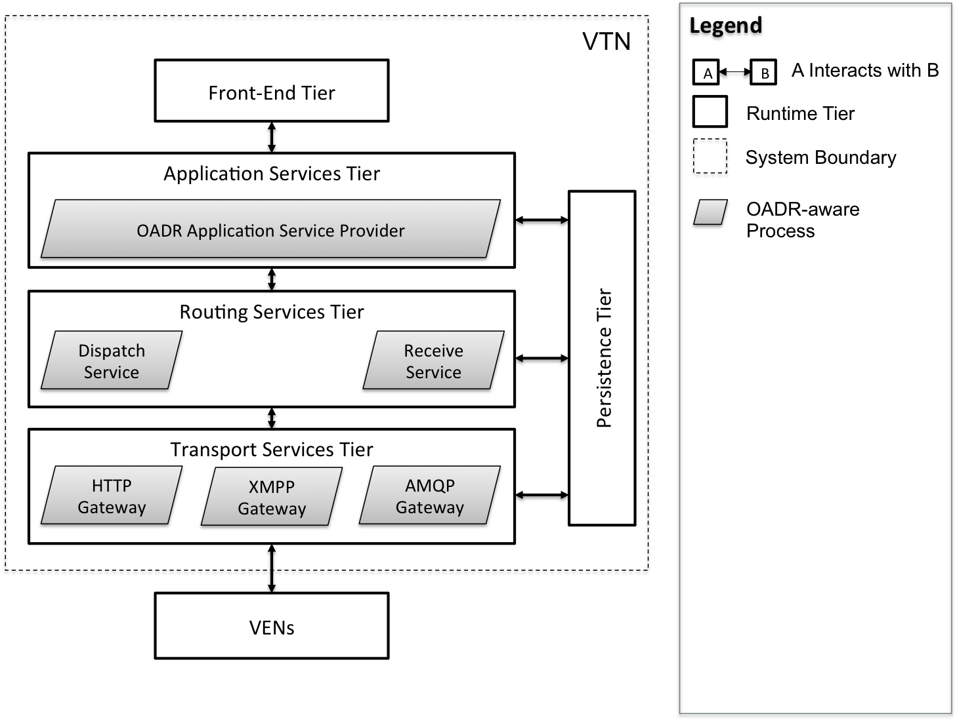
Dynamic Perspective, Process Allocation View

Slide 58

Static Perspective, OpenADR Service API

Slide 59
Performance Quality Attribute Scenarios
QA03 Outbound Latency: Outbound message latency is measured from the time an event is initiated from the Application Services tier to the time it exits the Transport Services tier. For any one message, the total outbound latency should not exceed 500ms.
QA04 Inbound Latency: Inbound message latency is measured from the time a message or request is received by the Transport Services tier to the time it is processed by the Persistence Tier. For any one message, the total inbound latency should not exceed 500ms.
QA05 Throughput: For both inbound and outbound communication paths, the VTN should be able to process 200 messages per second. That is, when distributing events to VENs, the VTN should be able to sustain a burst throughput of 200 messages per second. When receiving asynchronous requests or responses from VENs, the VTN should be able to sustain 200 transactions per second.

Slide 60
Deployability Quality Attribute Scenarios
QA10 Deployability: An administrator, familiar with a public or private cloud infrastructure, should be able to launch a VTN reference implementation and initiate a DR event in less than 20 minutes.

Slide 61
Availability Quality Attribute Scenarios
QA14 Fault Detection: A fault occurs; faults have been defined using an appropriate fault model. The VTN detects the fault and notifies systems administrators within one minute using either Email or SMS. Fault information contains sufficient detail such that system administrators can take corrective action.
QA13 Failure Recovery: A failure occurs; failures are traceable to a specific system fault. Manual recovery of any one module can be completed in less than 5 minutes. In the event of failure, no messages are lost in either the outbound or inbound message paths.

Slide 62
Security Quality Attribute Scenarios
QA12 Security: An attacker wishes to disrupt or manipulate a DR network in order to interrupt commercial or industrial operations or potentially damage equipment. The VTN does not respond to any illegitimate requests from unrecognized VENs or rogue applications.

Slide 63
Key Business Constraints
Constraint | Description
Cost Limitation | Fixed budget and schedule for studio project
Schedule Limitation | Incremental delivery
Legal Restriction | No third-party libraries or components Nondisclosure and waiver of intellectual rights
Market Restriction | Simple, understandable design and implementation Supports the OpenADR 2.0 specification Uses industry standard protocols
Logistical Demands | Public cloud infrastructure may be necessary for demonstrating the required scale and performance

Slide 64
Key Technical Constraints
Constraint | Description
Operating System | Target platform should be a Linux flavored operating system Amazon Machine Images (AMI) should support the selected OS
Computing Platform | The system should be verified on Amazon EC2 AMIs
Computer Languages | No usage of proprietary languages resulting in vendor lock-in Preferred computer languages are Java, Ruby or Python
Protocols/Standards | At a minimum, the system should support HTTP (SOAP/REST), XMPP, and an appropriate queuing protocol (e.g., AMQP or STOMP)
Tools/Methods | No proprietary software tools for developing, and testing the system
Computing Capacity | ADR system should support scaling out (scaling horizontally) by adding redundant computing and data storage nodes (servers).

Slide 65
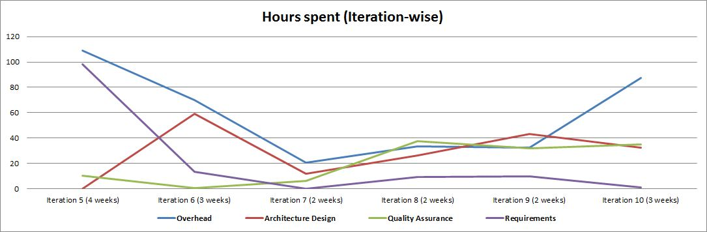
Time spent in activities

